Slide 1

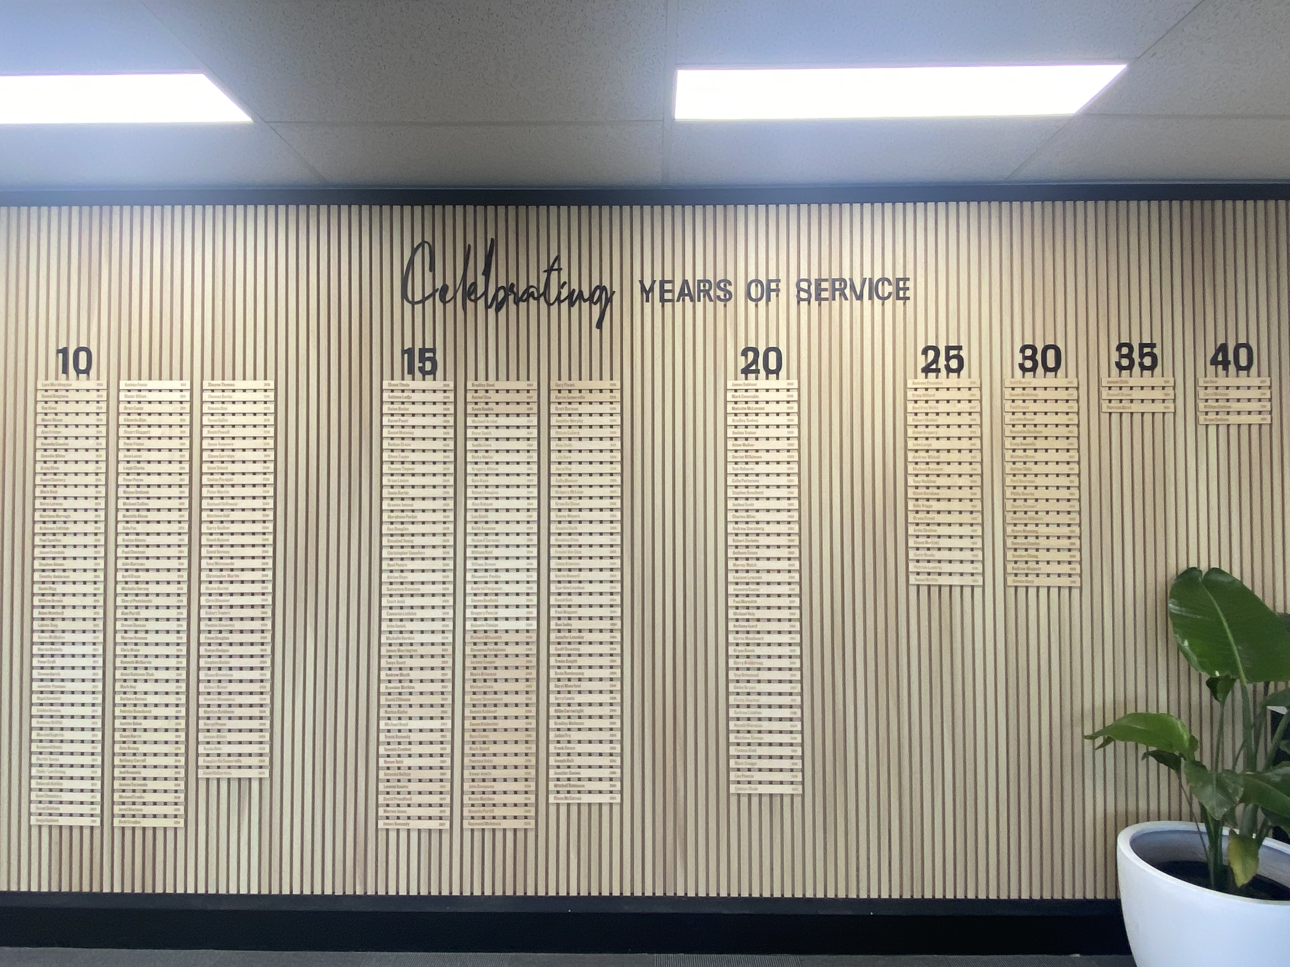
Predicting Employee Attrition Using Machine Learning
GROUP 4
Sandy Berahim | France Columbino | Irwine Young | Siyuan Zhu

Slide 2
Predicting Employee Attrition Using Machine Learning
Introduction
01
Machine Learning Process
02
Results & Discussion
03
Conclusion & Recommendation
04

Slide 3



EMPLOYEE ATTRITION
Loss of staff in a company due to retirement, resignation, or termination of employment
Voluntary Attrition (retirement, resignation)
Involuntary Attrition (termination, redundancy)
Internal Attrition (changing roles/department)
Introduction
01
According to Hays (Salary Guide 2022-2023), the Top 3 main drivers of employee attrition is:
Uncompetitive Salary
Lack of Promotional Opportunities
Poor Management Style or Workplace Culture

Slide 4

Problem Statement
Identify who among the current employees are likely to stay with the company or likely to move on
“But if many of your brightest and most productive employees are leaving, the resulting impact can be more than just financial – it can also adversely affect employee morale and the company's image”
(Seek Australia 2019)

Slide 5



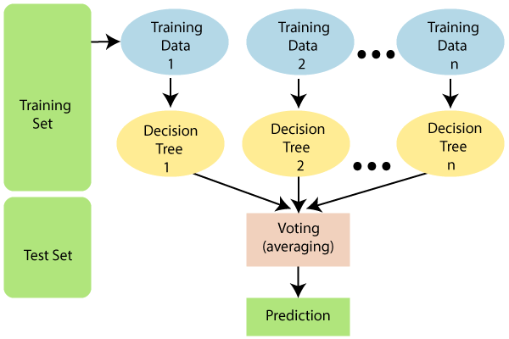

Machine Learning Model
Data Visualisation
TABLEAU | MATPLOTLIB
PYTHON | RANDOM FOREST
Data Source
IBM HR Analytics Employee Attrition & Performance
KAGGLE

Slide 6
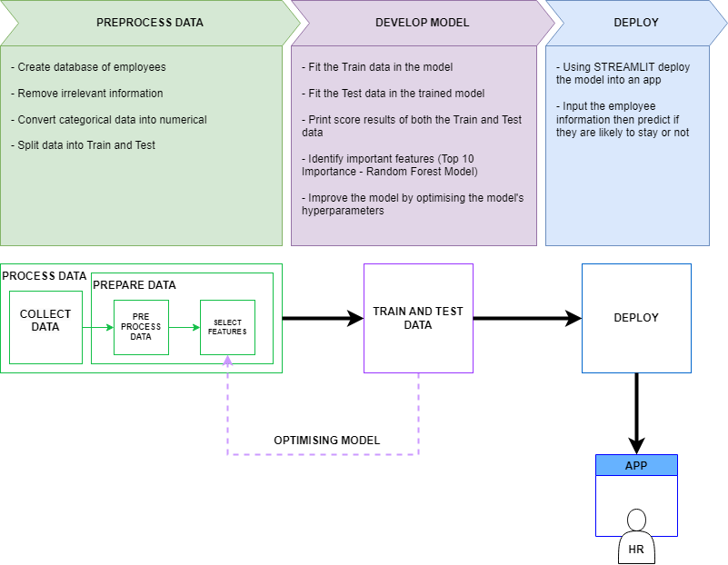
Machine Learning Process
02

Slide 7
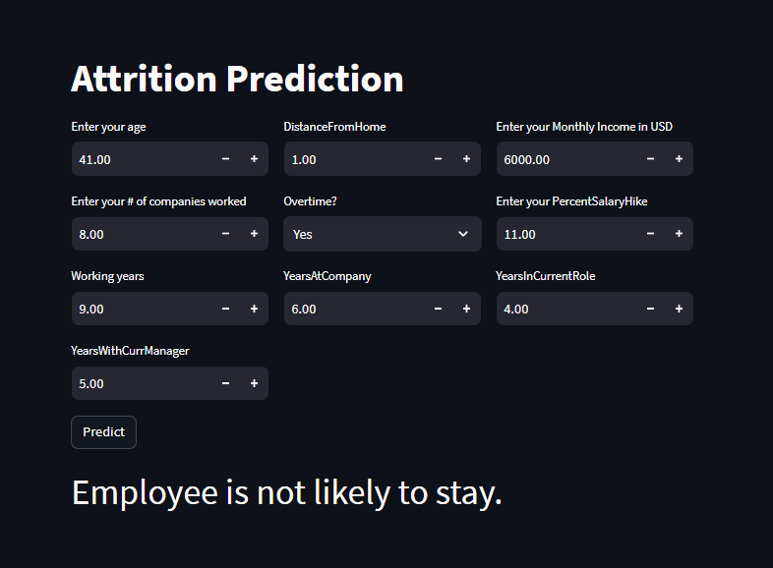
Machine Learning Process
02

Slide 8
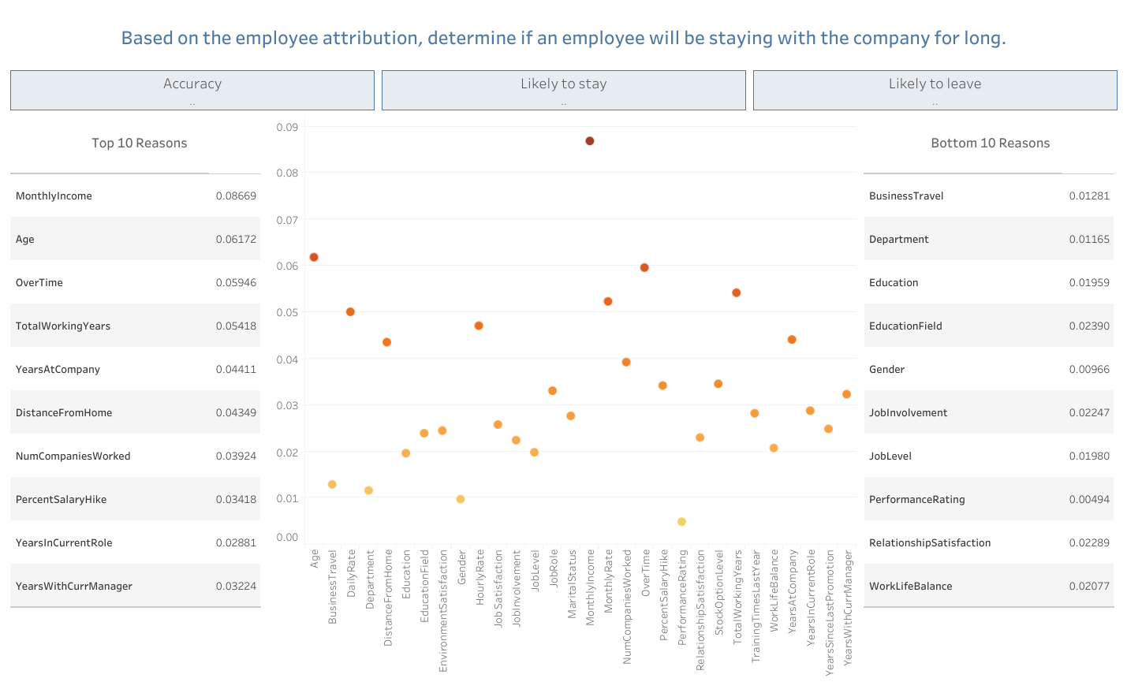
Feature: Monthly income
Feature Importance – Random Forest: 0.08669
Results & Discussion
03

Slide 9
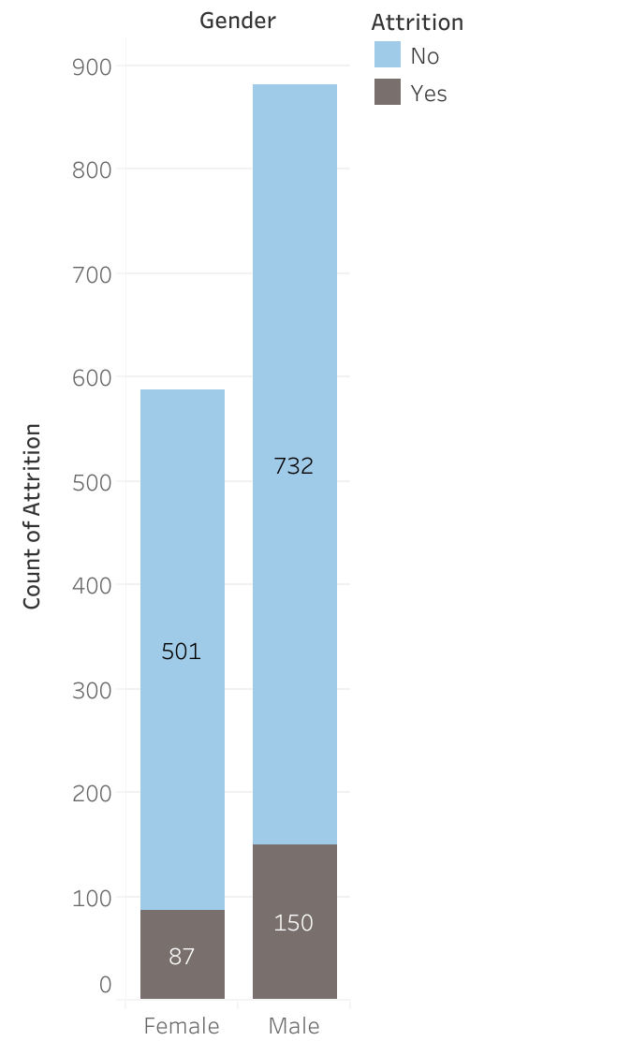
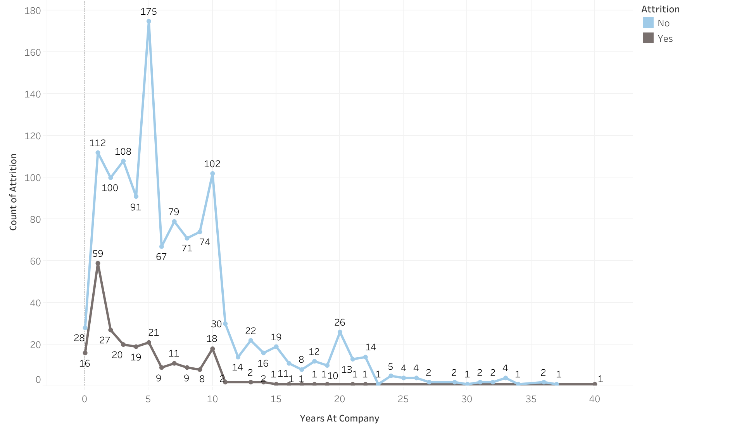
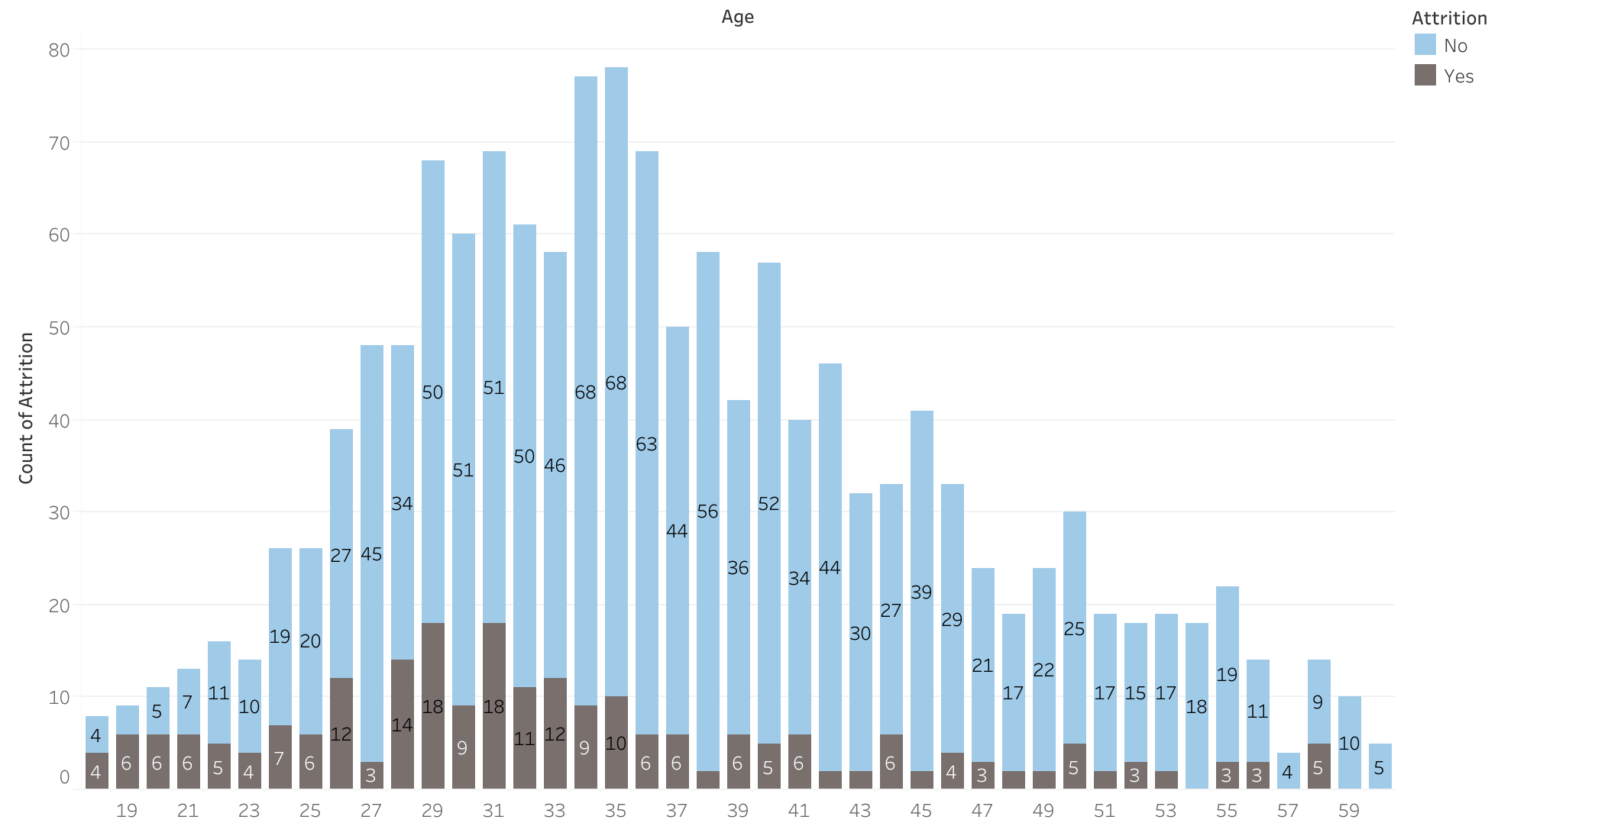
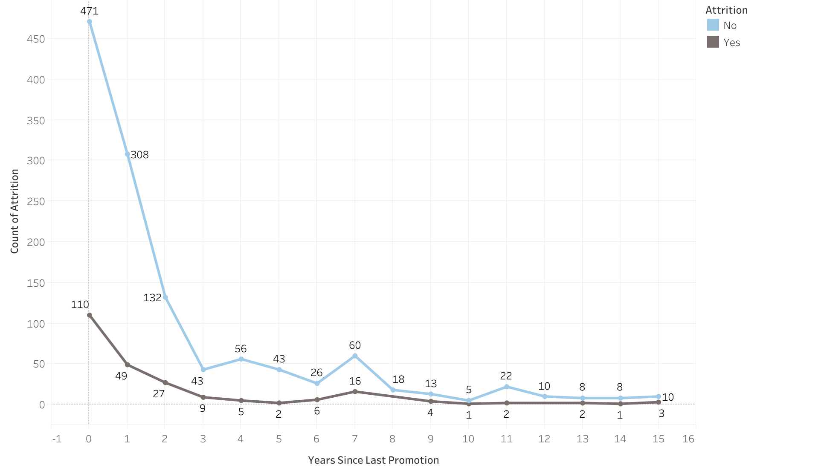
Comparing the effect of some features to employee’s attrition
Gender vs Attrition
Tenure vs Attrition
Age vs Attrition
Promotion vs Attrition

Slide 10
CONCLUSION
Identified the Top 10 Reasons why employees are staying or leaving the company:
Monthly Income
Age
Over Time
Total Working Years
Years at the Company
Distance from Home
Number of Companies Worked
Percent Salary Hike
Years in Current Role
Years with Current Manager
Accuracy of the ML model: 86%
More precise in predicting who are staying than who will be leaving
Conclusion & Recommendation
04
LIMITATIONs
A few features have been removed due to assumed redundancy (rates vs income) with the aim to lessen the bias within the data
The dataset itself is biased with having less attrition data
RECOMMENDATIONS
Use a dataset that is more relevant to Australia and its current employment climate
Other Machine Learning models, such as other deep learning models and logistic regression, can be used to test if they would yield a more optimised and accurate testing result

Slide 11
Thank you!

